Slide 1



SLOPED COMPARISONS
Comparing 2 Linear Regression Systems on Random Data
Process:
Generate a random set of points
Render a trend line for this data set with each regression
Repeat this process n times to generate multiple trendlines for each regression
Regression 1:
Find the average $\overline{x}$ and $\overline{y}$ and values for a a given random data set
Calculate a slope using $\frac{y−\overline{y}}{y−\overline{x}},$ for each (x, y) in the data set
Take the average of that slope
Solve for y-intercept with any random (x, y)
Regression 2:
For the 5 points at the beginning and end of the dataset, find the average $\overline{y}$ value.
Render a line from ( 0, ${\overline{y}}_{0}$ ) to ($x_{f},{\overline{y}}_{f}$)
${\overline{y}}_{0}$ is the average y value at the beginning of the dataset
${\overline{y}}_{f}$ is the average y value at the end of the dataset
$x_{f}$ is final x value in a dataset
Comparisons:
Different equations were used to generate the random datasets, to test the effectiveness of these regressions across multiple standards
The vertical range of the points, ∆y, was also changed
Marked by
Marked by

Slide 2
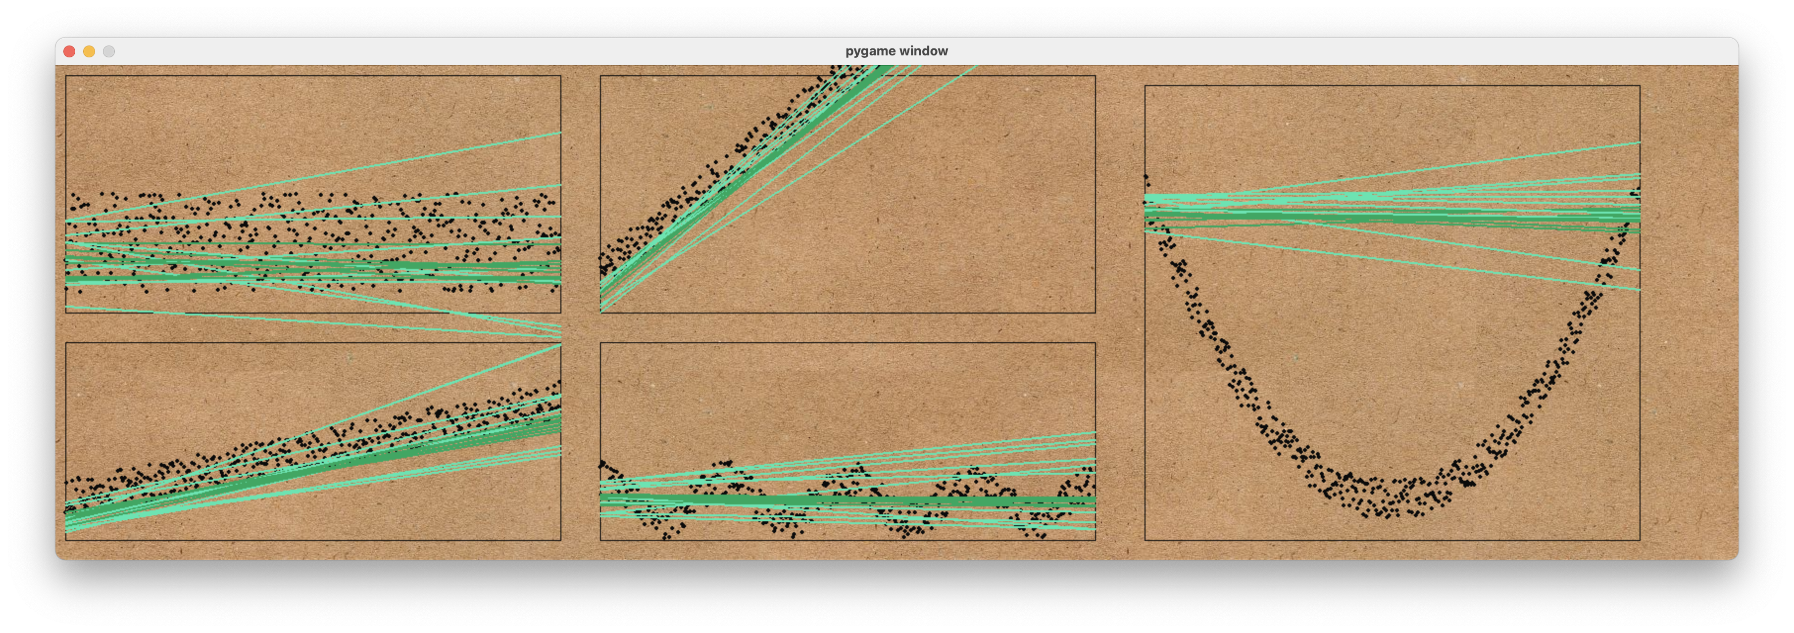
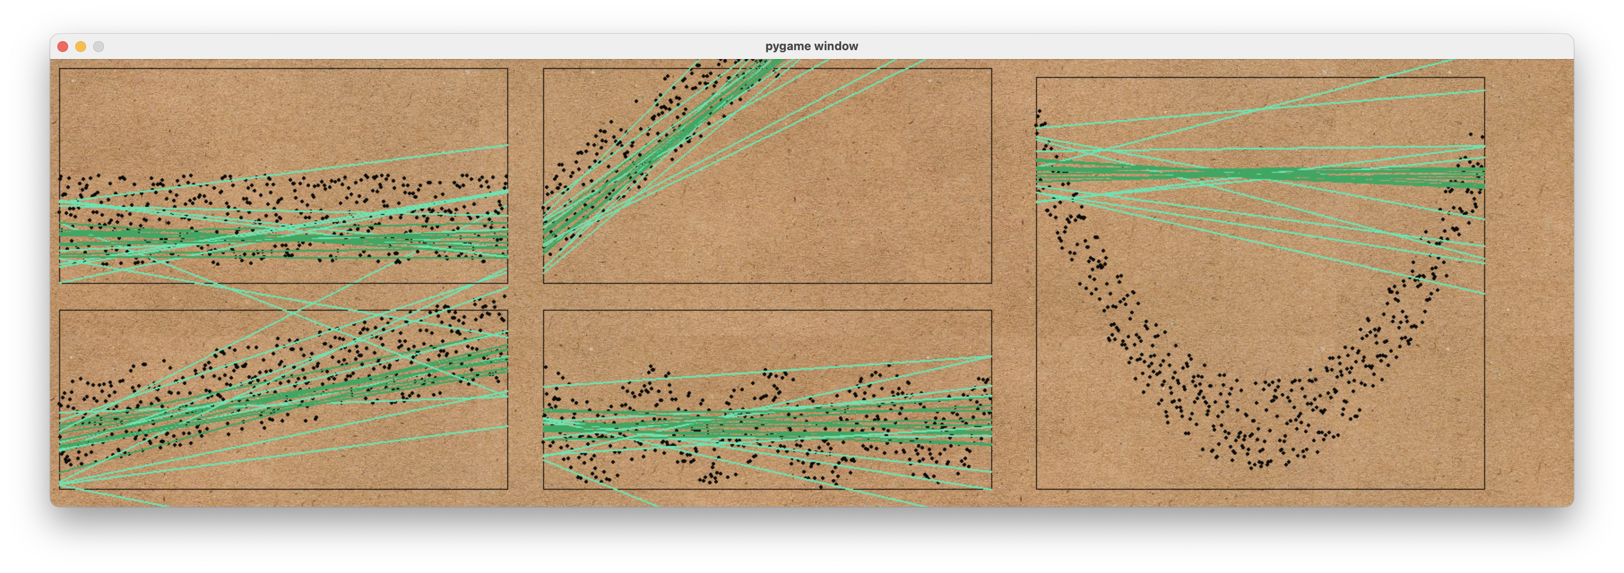
Y = 0
Y = 0.9x
Y = 0.005(x - 250)^2
Y = 0.1x
Y = 20(x * 0.05)
∆y = 50
∆y = 250

